Slide 1
E-Content Description
Name of School / College: M A Rangoonwala Institute of Hotel Management and Research
Maharashtra Cosmopolitan
Education Society’s
Azam Campus Pune 411001

Slide 2
Name and Designation of content creator /Producer | Assoc. Prof Imran Sayyed
Title of E content | Audio visual equipment
Theory/practical | Theory
Title and No of Module | Audio visual equipment
Title and code of Paper | The Science of Hotel Engineering Subject Code : HS 206
Broad Subject | Engineering
Course | BScHS
Class | SY
Semester | Third
University /Board | SPPU
Date of Content Creation | 3 Jan 2020
Name of Reviewer HOD/Principal | Imran Sayyed

Slide 3
Various audio visual equipment used in hotel
Audiovisual (AV) means possessing both a sound and a visual component, such as slide-tape presentations, films, television programs, church services and live theater productions.
Audiovisual service providers frequently offer web streaming, video conferencing and live broadcast services.
Computer-based audiovisual equipment is often used in education, with many schools and universities installing projection equipment and using interactive whiteboard technology.
Another audiovisual expression is the visual presentation of sound (visual music).

Slide 4
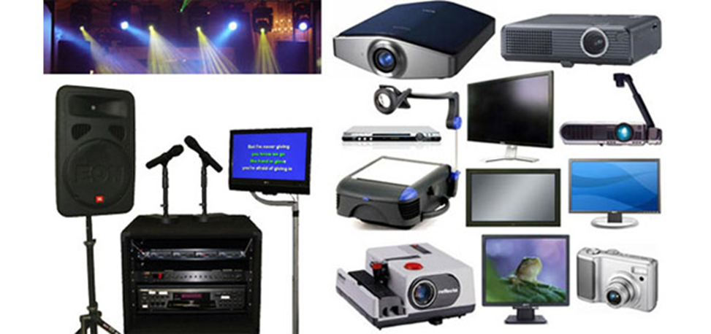
Various audio visual equipment used in hotel

Slide 5
LCD Projector
6x8 or 7x10 Fast Fold Professional Screen
Black Velour Drape (behind podium)
Wireless Microphone
Wireless Handheld Audience Q&A Microphone
Wireless Powerpoint Advancer Remote w/laser pointer
Computer Audio Patch
Skirted cart and all necessary cabling

Slide 6
LCD Projector
An LCD projector is a type of video projector for displaying video, images or computer data on a screen or other flat surface. It is a modern equivalent of the slide projector or overhead projector. To display images, LCD (liquid-crystal display) projectors typically send light from a metal-halide lamp through a prism or series of dichroic filters that separates light to three polysilicon panels – one each for the red, green and blue components of the video signal. As polarized light passes through the panels (combination of polarizer, LCD panel and analyzer), individual pixels can be opened to allow light to pass or closed to block the light. The combination of open and closed pixels can produce a wide range of colors and shades in the projected image.

Slide 7
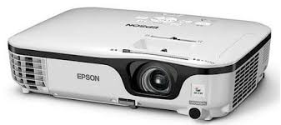
Data projectors
These are used to project an image from:
Classroom computer
Document camera
Laptop
Any other VGA compatible device
Uses
The most ubiquitous use of a data projector is for presentations in business meetings or classrooms. Presentation software allows a user to create slide shows of photos, type written information and display graphs. Teachers in high school and college make extensive use of data projectors to give notes or lectures, as do businesspeople making presentations to co-workers or clients.

Slide 8
Wireless microphones
These are used for presenters who will be presenting to an audience in larger lecture all or event space. Typically, powered speakers and a microphone mixer are needed as well.

Slide 9
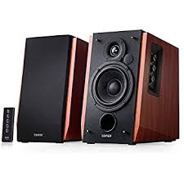
Powered Speakers
Powered speakers are used in conjunction with microphones and microphone mixers to provide audio for a large audience in a lecture hall or event space.

Slide 10
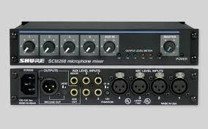
Microphone Mixers
Microphone mixers, or mixers, are used when multiple microphones and/or audio devices are connected to powered speakers.

Slide 11
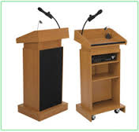
Podiums
(includes a built-in microphone)
All classrooms already have a metal table-top lectern. Podiums can be requested for larger lecture halls or special events in an event space.

Slide 12
Care and cleaning of overhead projector, slide projector, LCD and power point presentation units
Overhead Projectors:
Slide projector
LCD Projector
Maintenance of computers:
Laptop users
Printer

Slide 13
Sensors
In the broadest definition, a sensor is an electronic component, module, or subsystem whose purpose is to detect events or changes in its environment and send the information to other electronics, frequently a computer processor. A sensor is always used with other electronics, whether as simple as a light or as complex as a computer.

Slide 14
Sensors
Speed Sensor
Temperature Sensor
Passive Infrared Sensor
Ultrasonic Sensor

Slide 15
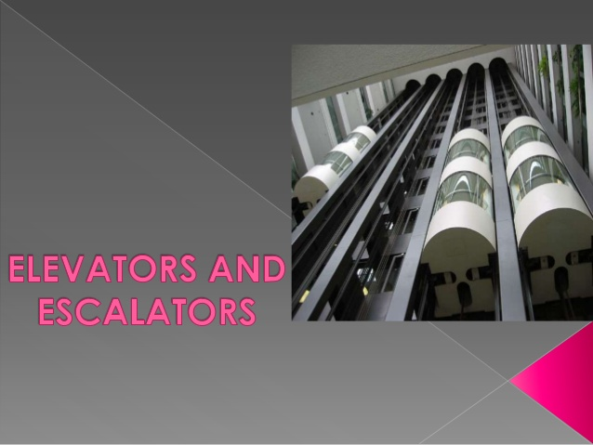
Transport Systems. (Elevators, Escalators)

Slide 16
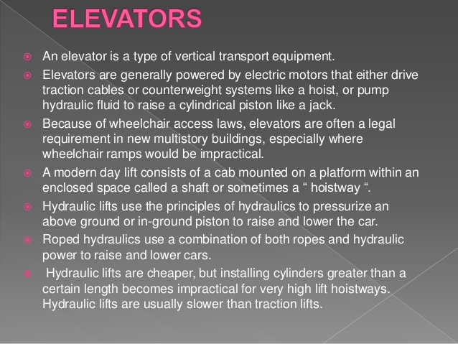

Slide 17
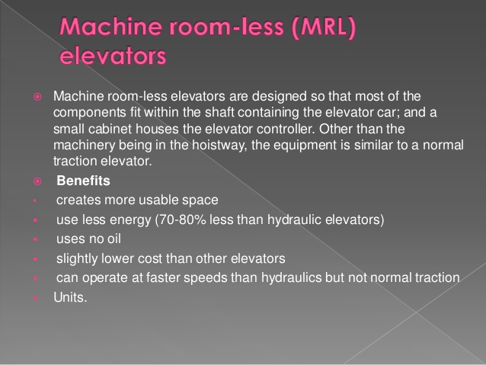

Slide 18
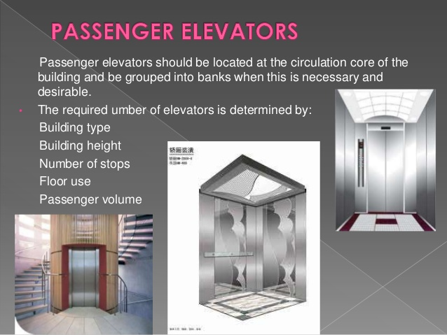

Slide 19
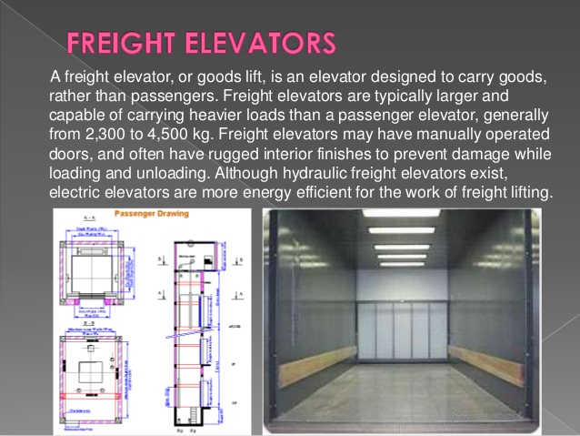

Slide 20
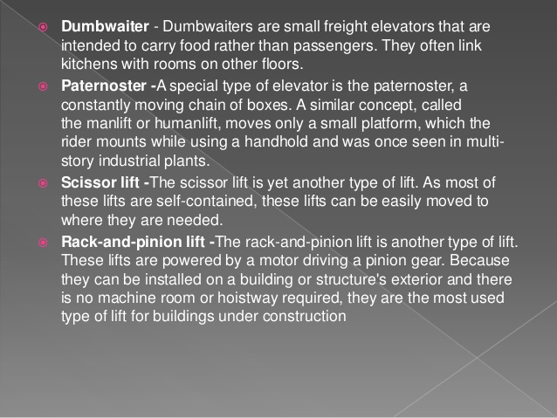

Slide 21
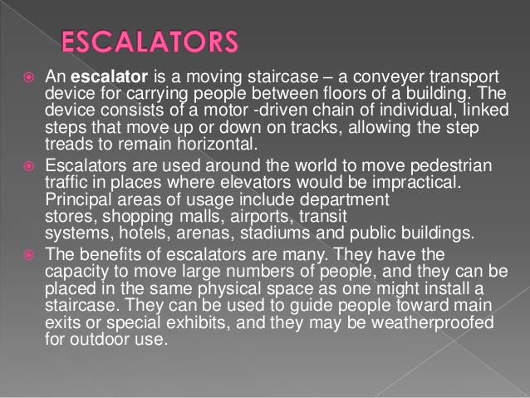

Slide 22
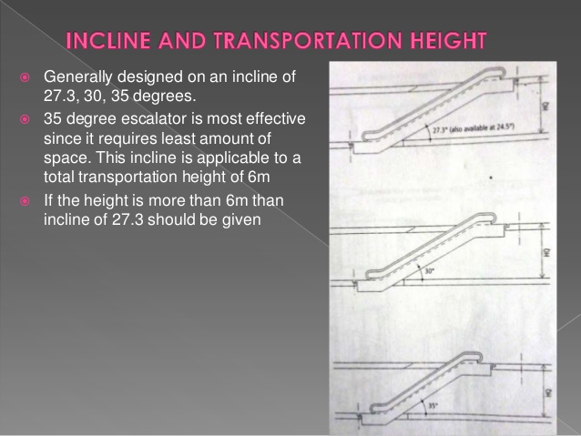

Slide 23
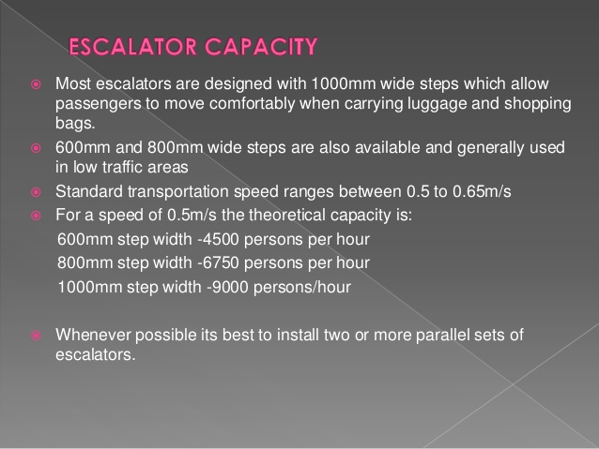

Slide 24
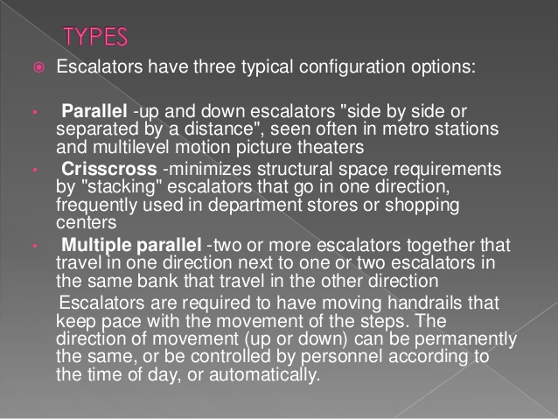

Slide 25
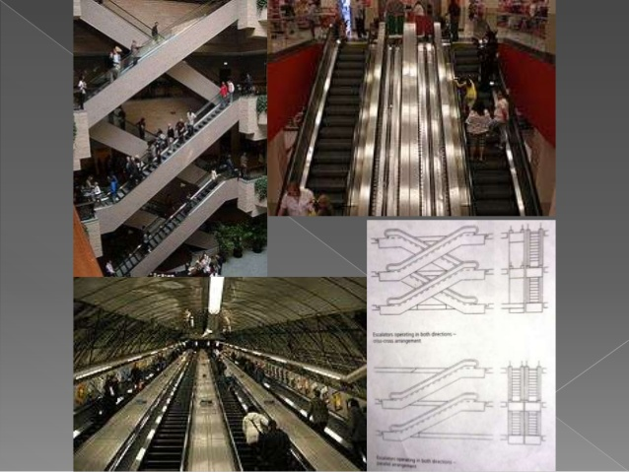

Slide 26
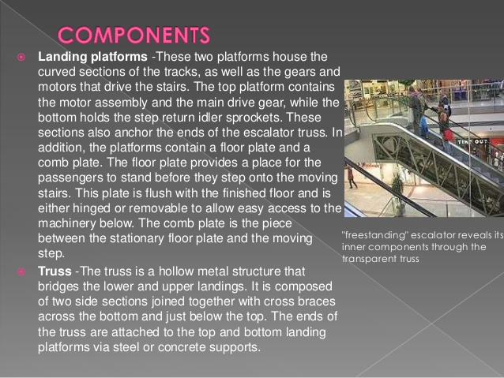

Slide 27
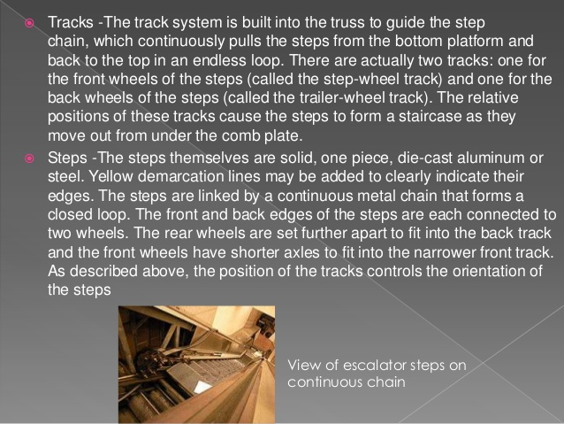

Slide 28
